Slide 1


Advanced Computer Architecture Fall 2020
Hamed Farbeh
farbeh@aut.ac.ir
Department of Computer Engineering
Amirkabir University of Technology
Lecture 2

Slide 2
Copyright Notice
Lectures adopted from
Computer Architecture: A Quantitative Approach, 5th edition, John L. Hennessy,‎ David A. Patterson, MK pub., 2019
Advanced Computer Architecture-Fall 2020, AUT, Tehran, Iran

Slide 3
Computer Architecture
A Quantitative Approach, Sixth Edition
Chapter 1
Fundamentals of Quantitative Design and Analysis

Slide 4
Computer Technology
Introduction
Performance improvements:
Improvements in semiconductor technology
Feature size, clock speed
Improvements in computer architectures
Enabled by HLL compilers, UNIX
Lead to RISC architectures
Together have enabled:
Lightweight computers
Productivity-based managed/interpreted programming languages

Slide 5
Current Trends in Architecture
Introduction
Cannot continue to leverage Instruction-Level parallelism (ILP)
Single processor performance improvement ended in 2003
New models for performance:
Data-level parallelism (DLP)
Thread-level parallelism (TLP)
Request-level parallelism (RLP)
These require explicit restructuring of the application

Slide 6
Parallelism
Classes of parallelism in applications:
Data-Level Parallelism (DLP)
Task-Level Parallelism (TLP)
Classes of architectural parallelism:
Instruction-Level Parallelism (ILP)
Vector architectures/Graphic Processor Units (GPUs)
Thread-Level Parallelism
Request-Level Parallelism
Classes of Computers

Slide 7
Flynn’s Taxonomy
Single instruction stream, single data stream (SISD)
Single instruction stream, multiple data streams (SIMD)
Vector architectures
Multimedia extensions
Graphics processor units
Multiple instruction streams, single data stream (MISD)
No commercial implementation
Multiple instruction streams, multiple data streams (MIMD)
Tightly-coupled MIMD
Loosely-coupled MIMD
Classes of Computers

Slide 8
Computer Architecture Topics
Input/Output and Storage
Disks, WORM, Tape
RAID
Emerging Technologies
Interleaving
Bus protocols
DRAM
Memory
Hierarchy
Coherence,
Bandwidth,
Latency
L2 Cache
VLSI
L1 Cache
Addressing,
Protection,
Exception Handling
Instruction Set Architecture
Pipelining, Hazard Resolution,
Superscalar, Reordering,
Prediction, Speculation,
Vector, DSP
Pipelining and Instruction
Level Parallelism

Slide 9
Defining Computer Architecture
“Old” view of computer architecture:
Instruction Set Architecture (ISA) design
i.e. decisions regarding:
registers, memory addressing, addressing modes, instruction operands, available operations, control flow instructions, instruction encoding
“Real” computer architecture:
Specific requirements of the target machine
Design to maximize performance within constraints: cost, power, and availability
Includes ISA, microarchitecture, hardware
Defining Computer Architecture

Slide 10
Trends in Technology
Integrated circuit technology (Moore’s Law)
Transistor density: 35%/year
Die size: 10-20%/year
Integration overall: 40-55%/year
DRAM capacity: 25-40%/year (slowing)
8 Gb (2014), 16 Gb (2019), possibly no 32 Gb
Flash capacity: 50-60%/year
8-10X cheaper/bit than DRAM
Magnetic disk capacity: recently slowed to 5%/year
Density increases may no longer be possible, maybe increase from 7 to 9 platters
8-10X cheaper/bit then Flash
200-300X cheaper/bit than DRAM
Trends in Technology

Slide 11
Bandwidth and Latency
Bandwidth or throughput
Total work done in a given time
32,000-40,000X improvement for processors
300-1200X improvement for memory and disks
Latency or response time
Time between start and completion of an event
50-90X improvement for processors
6-8X improvement for memory and disks
Trends in Technology

Slide 12
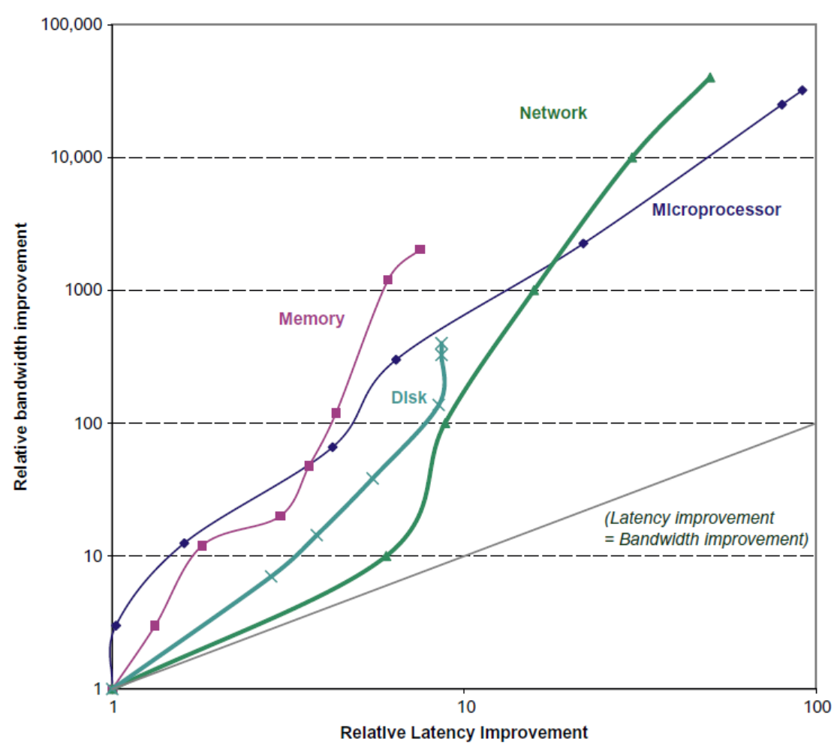
Bandwidth and Latency
Trends in Technology
Log-log plot of bandwidth and latency milestones

Slide 13
Transistors and Wires
Feature size
Minimum size of transistor or wire in x or y dimension
10 microns in 1971 to .011 microns in 2017
Transistor performance scales linearly
Wire delay does not improve with feature size!
Integration density scales quadratically
Trends in Technology

Slide 14
Power and Energy
Thermal Design Power (TDP)
Maximum amount of heat generated by a chip
Characterizes sustained power consumption
Used as target for power supply and cooling system
Lower than peak power (1.5X higher), higher than average power consumption
Clock rate can be reduced dynamically to limit power consumption
Energy per task is often a better measurement
Trends in Power and Energy

Slide 15
Dynamic Energy and Power
Dynamic energy
Transistor switch from 0 → 1 or 1 → 0
½ x Capacitive load x Voltage²
Dynamic power
½ x Capacitive load x Voltage² x Frequency switched
Reducing clock rate reduces power, not energy
Trends in Power and Energy

Slide 16
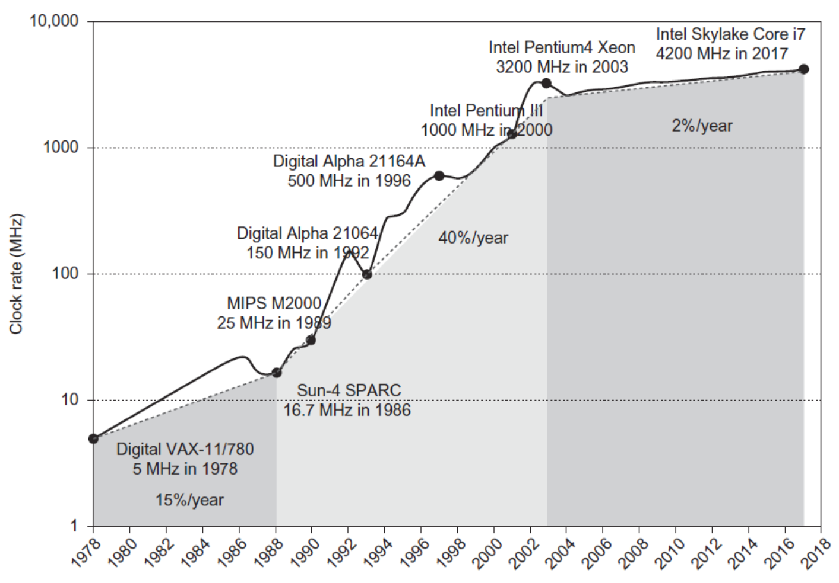
Power
Intel 80386 consumed ~ 2 W
3.3 GHz Intel Core i7 consumes 130 W
Heat must be dissipated from 1.5 x 1.5 cm chip
This is the limit of what can be cooled by air
Trends in Power and Energy

Slide 17
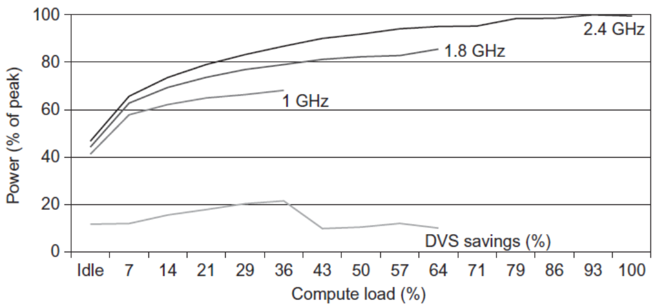
Reducing Power
Techniques for reducing power:
Do nothing well
Dynamic Voltage-Frequency Scaling
Low power state for DRAM, disks
Overclocking, turning off cores
Trends in Power and Energy

Slide 18
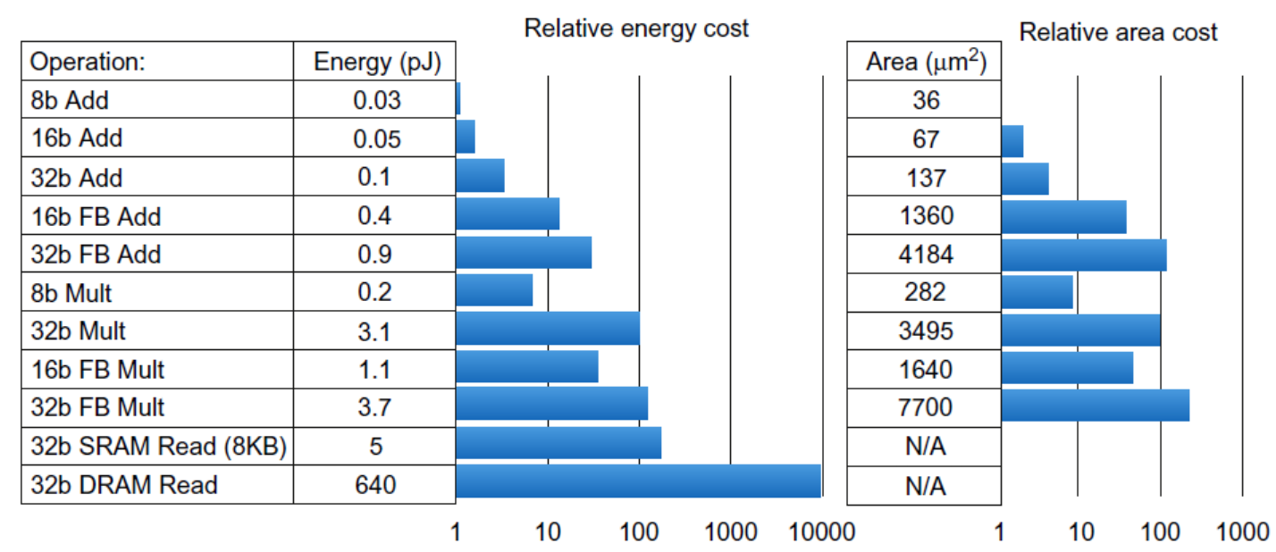
Static Power
Static power consumption
25-50% of total power
Current_{static} x Voltage
Scales with number of transistors
To reduce: power gating
Trends in Power and Energy

Slide 19
Measuring Performance
Typical performance metrics:
Response time
Throughput
Speedup of X relative to Y
Execution time_{Y} / Execution time_{X}
Execution time
Wall clock time: includes all system overheads
CPU time: only computation time
Benchmarks
Kernels (e.g. matrix multiply)
Toy programs (e.g. sorting)
Synthetic benchmarks (e.g. Dhrystone)
Benchmark suites (e.g. SPEC06fp, TPC-C)
Measuring Performance

